Slide 1
WEB APPLICATION DEVELOPMENT USING FULL STACK-Module-II
1
JAVA SERVLETS
CSE(AI&ML) A.Y.:2022-23

Slide 2
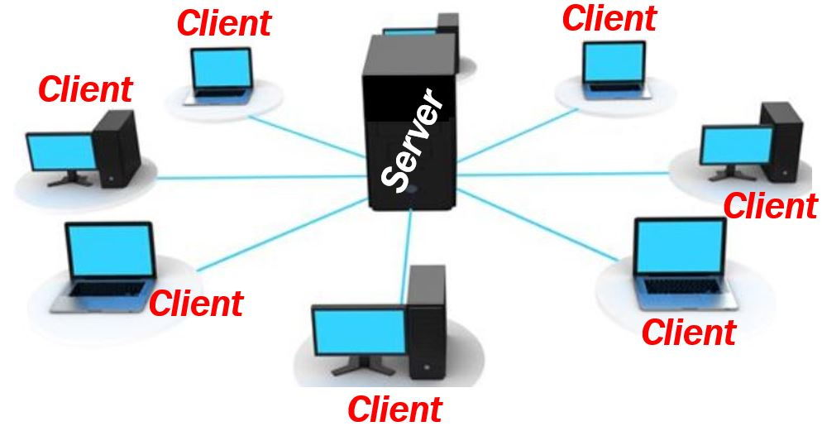
Introduction
Server: A Server is a program or device that provides services or functionalities for other programs or devices called Clients.
To develop any web based application a web browser will be act as client.
CSE(AI&ML) A.Y.:2022-23

Slide 3
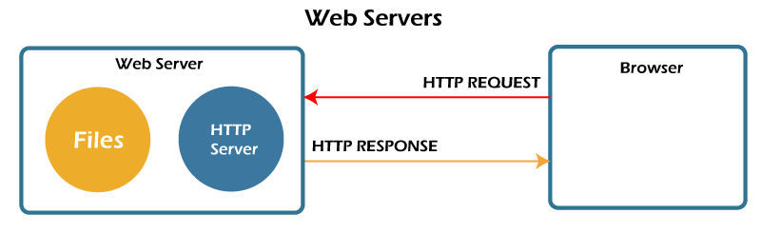
Types of Servers
Mail Server
Print Server
File Server
Database Server
Webserver : It is used to run or develop web applications on the client system. Some of the popular web servers are
Apache Tomcat Web Server
BEA Web Logic Server
Google Web Server
WAMP,XAMPP,LAMP
CSE(AI&ML) A.Y.:2022-23

Slide 4
Execution Process
To run any web application in the web server, we need to follow the directory structure.
Root Directory
WEB-INF
classes
.html files
src
lib
.html files
web.xml
.html files
.html files
CSE(AI&ML) A.Y.:2022-23

Slide 5
Web.xml file
This is the configuration file of web applications in java.
It instructs the servlet container (tomcat for ex.) which classes to load, what parameters to set in the context, and how to intercept requests coming from browsers.
The root tag for web.xml file is <web-app>
<web-app>
// It contains servlets Information
</web-app>
CSE(AI&ML) A.Y.:2022-23

Slide 6
Java Servlet
A Servlet is a simple Java Program used to add dynamic nature to static Webpage.
It is a server side scripting language, means to process or execute a servlet we require a suitable webserver i.e. Tomcat web server provided by Apache software Foundation.
To create a Servlet file, we need to follow servlet API available in the package
javax.servlet.*; (or) javax.servlet.http.*;
CSE(AI&ML) A.Y.:2022-23

Slide 7
Creation of a Servlet
To create a servlet use the following techniques
Extending GenericServlet Class
Extending HttpServlet Class
GenericServlet is a super class of HttpServlet class.
GenericServlet belongs to javax.servlet package.
HttpServlet belongs to javax.servlet.http package.
The main difference is that, HttpServlet is a protocol dependent whereas GenericServlet is protocol independent.
So GenericServlet can handle all types of protocols, but HttpServlet handle only HTTP specific protocols.
CSE(AI&ML) A.Y.:2022-23

Slide 8
In the GenericServlet, we need to implement service() method to handle the client requests.
But, In case of HttpServlet, we need to choose a method based on type of Http Request.. i.e. GET and POST.
CSE(AI&ML) A.Y.:2022-23

Slide 9
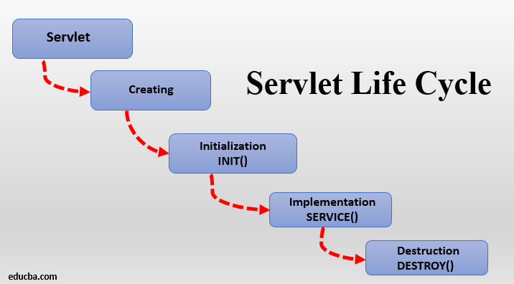
Servlet Life Cycle
CSE(AI&ML) A.Y.:2022-23

Slide 10
Methods in GenericServlet Class
public void init(ServletConfig config) is used to initialize the servlet.
public abstract void service(ServletRequest request, ServletResponse response) provides service for the incoming request. It is invoked at each time when user requests for a servlet.
public void destroy() is invoked only once throughout the life cycle and indicates that servlet is being destroyed.
CSE(AI&ML) A.Y.:2022-23

Slide 11
Simple Example
public class First extends GenericServlet
{
public void init()
{
}
public void service()
{
}
public void destroy() { }
}
CSE(AI&ML) A.Y.:2022-23

Slide 12
Example
import javax.servlet.*;
import java.io.*;
public class Simple extends GenericServlet
{
public void service(ServletRequest req,ServletResponse res) throws ServletException,IOException
{
res.setContentType(“text/html”);
PrintWriter out=res.getWriter();
out.println(“Welcome to Servlets”);
out.println(“<h1>Hello World</h1>”);
} }
CSE(AI&ML) A.Y.:2022-23

Slide 13
Web.xml
<web-app>
<servlet>
<servlet-name>FirstServlet</servlet-name>
<servlet-class>Simple</servlet-class>
</servlet>
<servlet-mapping>
<servlet-name>FirstServlet</servlet-name>
<url-pattern>/csm</url-pattern>
</servlet-mapping>
</web-app>
CSE(AI&ML) A.Y.:2022-23

Slide 14
Example
Write a Java Servlet Program to print the Current System Date and Time.
CSE(AI&ML) A.Y.:2022-23

Slide 15
Establish the connection between .html and servlet file
<form action=“url-pattern-name”>
<input type=“submit” value=“Invoke Servlet”>
</form>
To retrieve the data from HTML form use getParameter() method from Request object.
String getParameter(String FieldName)
CSE(AI&ML) A.Y.:2022-23

Slide 16
Exampl
<input type=“text” name=“t1”>
To retrieve the data from form
String x=req.getParameter(“t1”);
CSE(AI&ML) A.Y.:2022-23

Slide 17
Example
<html>
<body>
<form action=“ret”>
Enter Name: <input type=“text” name=“t1”>
<input type=“submit” value=“submit”>
</form>
</body>
</html>
CSE(AI&ML) A.Y.:2022-23

Slide 18
import javax.servlet.*;
import java.io.*;
public class Retrive extends GenericServlet
{
public void service(ServletRequest req,ServletResponse res) throws ServletException,IOException
{
res.setContentType(“text/html”);
PrintWriter out=res.getWriter();
String na=req.getParameter(“t1”);
out.println(“Enterd name is”+na);
} }
CSE(AI&ML) A.Y.:2022-23

Slide 19
Web.xml
<web-app>
<servlet>
<servlet-name>SecondServlet</servlet-name>
<servlet-class>Retrive</servlet-class>
</servlet>
<servlet-mapping>
<servlet-name>SecondServlet</servlet-name>
<url-pattern>/ret</url-pattern>
</servlet-mapping>
</web-app>
CSE(AI&ML) A.Y.:2022-23

Slide 20
HttpServlet Example
public class Sample extends HttpServlet
{
public void doGet(HttpServletRequest req,HttpServletResponse res) throws ServletException,IOException
{
//code
}
}
CSE(AI&ML) A.Y.:2022-23

Slide 21
<
To add Welcome file list for web application
<welcome-file-list>
<welcome-file>main.html</welcome-file>
</welcome-file-list>
CSE(AI&ML) A.Y.:2022-23

Slide 22
Redirection or Navigation to another webpage
To redirect to another webpage use sendRedirect() Method available in the HttpServletResponse object.
Syntax:
res.sendRedirect(“Html File”);
(or)
res.sendRedirect(“Url Pattern”);
CSE(AI&ML) A.Y.:2022-23

Slide 23
Request Dispatcher
The RequestDispatcher interface provides the facility of dispatching the request to another resource it may be html, servlet or jsp.
This interface can also be used to include the content of another resource also.
CSE(AI&ML) A.Y.:2022-23

Slide 24
Methods of RequestDispatcher interface
The RequestDispatcher interface provides two methods. They are:
public void forward(ServletRequest request,ServletResponse response):Forwards a request from a servlet to another resource (servlet, JSP file, or HTML file) on the server.
public void include(ServletRequest request,ServletResponse ):Includes the content of a resource (servlet, JSP page, or HTML file) in the response.
CSE(AI&ML) A.Y.:2022-23

Slide 25
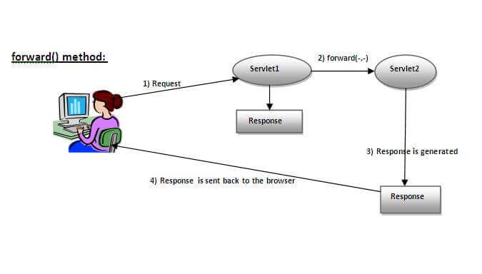
CSE(AI&ML) A.Y.:2022-23

Slide 26
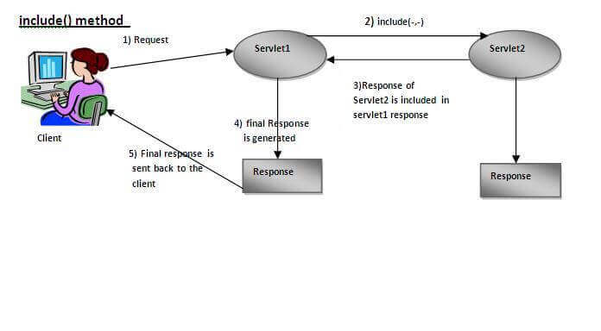
CSE(AI&ML) A.Y.:2022-23

Slide 27
Example Code
RequestDispatcher rd=req.getRequestDispatcher("servlet2");
//servlet2 is the url-pattern of the second servlet
rd.forward(req, res);
CSE(AI&ML) A.Y.:2022-23

Slide 28
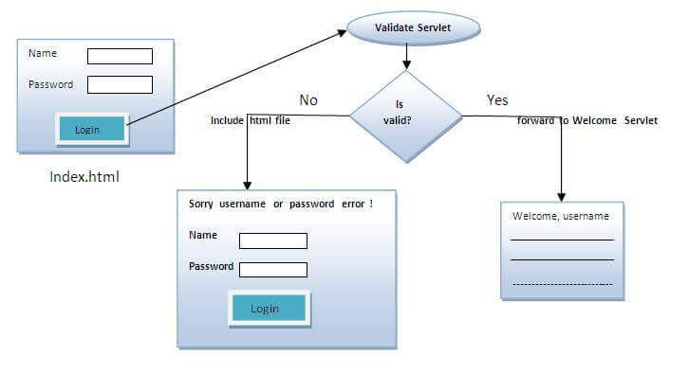
Example Program
CSE(AI&ML) A.Y.:2022-23

Slide 29
index.html file: for getting input from the user.
Login.java file: a servlet class for processing the response. If it is success, it will forward the request to the welcome servlet.
WelcomeServlet.java file: a servlet class for displaying the welcome message.
CSE(AI&ML) A.Y.:2022-23

Slide 30
Index.html
<form action="servlet1" method="post">
Name:<input type="text" name="userName"/><br/>
Password:<input type="password" name="userPass"/><br/>
<input type="submit" value="login"/>
</form>
CSE(AI&ML) A.Y.:2022-23

Slide 31
Login.java
If((u.equals(“csm”)&&(p.equals(“csm”)){
RequestDispatcher rd=request.getRequestDispatcher("servlet2");
rd.forward(request, response);
}
else{
out.print("Sorry UserName or Password Error!");
RequestDispatcher rd=request.getRequestDispatcher("index.html");
rd.include(request, response);
}
CSE(AI&ML) A.Y.:2022-23

Slide 32
WelcomeServlet.java
response.setContentType("text/html");
PrintWriter out = response.getWriter();
String n=request.getParameter("userName");
out.print("Welcome "+n);
CSE(AI&ML) A.Y.:2022-23

Slide 33
Exercise Programs
Login Validation by connecting with Oracle Data base
Registration form
Change Password Form.
CSE(AI&ML) A.Y.:2022-23

Slide 34
Session Management
Session simply means a particular interval of time.
The time period between login and logout is treated as session.
Session Tracking is a way to maintain state (data) of an user. It is also known as session management in servlet.
During the period, user may use multiple web pages.
Http Protocol is used to maintain the interaction between client and server.
But Http Protocol is a Stateless Protocol.
CSE(AI&ML) A.Y.:2022-23

Slide 35
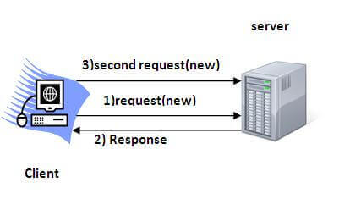
Http Protocol is a Stateless Protocol means, it is not going to maintain state of a particular user.
Because, it treats every request as new request, so it forgets the previous data.
CSE(AI&ML) A.Y.:2022-23

Slide 36
So, to maintain state of a particular user we need to maintain session information using session tracking.
To Manage sessions, the popular techniques are
Cookies
HttpSession
CSE(AI&ML) A.Y.:2022-23

Slide 37
Cookies
A Cookie is a Small Piece of information stored on the client system or web browser.
Every Cookie Contains two Components
Cookie Name
Cookie Value
Cookies are classified into 2 types
Persistent Cookie
Non-Persistent Cookie
CSE(AI&ML) A.Y.:2022-23

Slide 38
Non-Persistent Cookie: Cookie data will be lost once browser is closed.
It is valid for single session only. It is removed each time when user closes the browser.
Example: Banking
Persistent Cookie: It is valid for multiple session . It is not removed each time when user closes the browser. It is removed only if user logout or signout.
Example: gmail, Facebook…
CSE(AI&ML) A.Y.:2022-23

Slide 39
Advantage of Cookies
Simplest technique of maintaining the state.
Cookies are maintained at client side.
Disadvantage of Cookies
It will not work if cookie is disabled from the browser.
Only textual information can be set in Cookie object.
CSE(AI&ML) A.Y.:2022-23

Slide 40
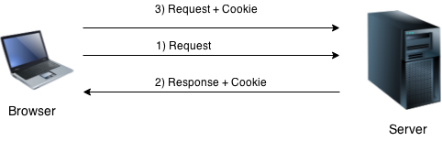
How Cookie Works
By default, each request is considered as a new request.
In cookies technique, we add cookie with response from the servlet. So cookie is stored in the cache of the browser.
After that if request is sent by the user, cookie is added with request by default. Thus, we recognize the user as the old user.
CSE(AI&ML) A.Y.:2022-23

Slide 41
Creation of Cookie
To create a cookie use a built in class Cookie available in the javax.servlet.http package.
To create cookie use the following constructors:
Cookie()
Cookie(String name, String Value)
Example:
Cookie c1=new Cookie();
Cookie c2=new Cookie(“branch”,”csm”);
CSE(AI&ML) A.Y.:2022-23

Slide 42
Methods of Cookie Class
setName(): It is used to assign or modify a name to a cookie.
Example:
Cookie c=new Cookie();
c.setName(“Branch”);
setValue(): It is used to assign the value of a Cookie.
Example:
c.setValue(“CSM”);
getName()
getValue()
CSE(AI&ML) A.Y.:2022-23

Slide 43
To store the information on the cookie use a method addCookie() available in the response object.
Syntax:
res.addCookie(Cookie_object);
To retrieve the information from the browser use a method getCookies() available in the request object.
Syntax:
Cookie c[]=req.getCookies();
CSE(AI&ML) A.Y.:2022-23

Slide 44
Example- Cook1.html
<form action=“c1” method=“post”>
Name:<input type=“text” name=“t1”><br>
<input type=“submit” value=“go”>
</form>
CSE(AI&ML) A.Y.:2022-23

Slide 45
Cook1.java (Servlet File)
public class Cook1 extends HttpServlet
{
public void doPost(HttpServletRequest req,HttpServletResponse res) throws ServletException,IOException
{
String name=req.getParameter(“t1”);
Cookie c1=new Cookie(“NAME”,name);
res.addCookie(c1);
res.sendRedirect(“cook2.html”);
}
}
CSE(AI&ML) A.Y.:2022-23

Slide 46
Example- Cook2.html
<form action=“c2” method=“post”>
Enter Branch:<input type=“text” name=“t2”><br>
<input type=“submit” value=“go”>
</form>
CSE(AI&ML) A.Y.:2022-23

Slide 47
Cook2.java (Servlet File)
public class Cook2 extends HttpServlet
{
public void doPost(HttpServletRequest req,HttpServletResponse res) throws ServletException,IOException
{
String branch=req.getParameter(“t2”);
Cookie c[]=req.getCookies();
res.setContentType(“text/html”);
PrintWriter out=req.getWriter();
out.println(“Name is”+c[0].getValue());
out.println(“Branch is”+branch);
}
}
CSE(AI&ML) A.Y.:2022-23

Slide 48
HttpSession
It is a class available in javax.servlet.http package.
It is used to store entire session information of a particular client.
All session objects are managed by web server.
HTTP session allows Web servers to maintain user identity and to store user-specific data during multiple request/response interactions between a client and server.
Whenever a session starts automatically a server assign unique session id.
CSE(AI&ML) A.Y.:2022-23

Slide 49
Creation of Session
To create a session use a class HttpSession
To create a session use a method getSession() from the request object.
Example:
HttpSession s=req.getSession();-- It returns existing session or if session not available then it creates new one.
HttpSession s=req.getSession(true);--Always Creates new one
HttpSession s=req.getSession(false);--();-- It returns existing session or if session not available then it creates new one.
CSE(AI&ML) A.Y.:2022-23

Slide 50
Methods
getId(): It returns Session Id
isNew(): It returns true if the session is new otherwise it returns false.
getCreationTime(): It returns the time when the session was created.
setMaxInactiveInterval(): It specifies time limit of a session
setAttribute(“Name”,”value”)
getAttribute(“Name”)
CSE(AI&ML) A.Y.:2022-23

Slide 51
HttpSession s1=req.getSession(true);
s1.setAttribute(“BRANCH”,”CSM”);
To retrieve from the Session
HttpSession s1=req.getSession();
String value=s1.getAttribute(“BRANCH”);
CSE(AI&ML) A.Y.:2022-23

Slide 52
To prevent data after logout from back button, use the following method setHeader()
void setHeader(String name,String value):
Sets a response header with the given name and value. If the header had already been set, the new value overwrites the previous one.
… To control cache memory of the web browser use a filed name
Cache-Control and the value is no-cache
res.setHeader(“Cache-Control”,”no-cache”);
res.setHeader(“Cache-Control”,”no-store”);
CSE(AI&ML) A.Y.:2022-23

Slide 53
no-store: The no-store response directive indicates that any caches of any kind (private or shared) should not store this response.no-cache
no-cache: The no-cache response directive indicates that the response can be stored in caches, but the response must be validated with the origin server before each reuse.
response.setDateHeader(“Expires”,0);
The Expires header specifies when content will expire, or how long content is “fresh.”
CSE(AI&ML) A.Y.:2022-23

Slide 54
Example
Write a Program to display a message “Welcome” for the first visit and display a message “Thank you” for visiting again for next time.
CSE(AI&ML) A.Y.:2022-23

Slide 55
HttpSession s=req.getSession();
Integer count=(Integer)s.getAttribute(“num”);
if(count==null)
{
Count=new Integer(1);
Out.println(“Welcome”);
}
else
{
CSE(AI&ML) A.Y.:2022-23

Slide 56
Out.println(“Thank you for visiting again”);
Count=new Integer(count.intValue()+1);
}
s.setAttribute(“num”,count);
s.setMaxInactiveInterval(60);
Out.println(“Number of visits”+count);
}
CSE(AI&ML) A.Y.:2022-23

Slide 57
JAVA SERVER PAGES (JSP)

Slide 58
Introduction
It is similar to java servlets.
It is also server side scripting language; used to dynamic nature to static web pages.
JSP is extension of Servlets.
In servlets presentation logic is embedded in the Business logic i.e. java code.
Example: out.println(“<h1>Welcome</h1>”);
If we modify the presentation logic, we need to recompile and redeploy in the server again.
CSE(AI&ML) A.Y.:2022-23

Slide 59
To overcome in this, in JSP business logic is embedded in the Presentation logic. If we modify any presentation logic, then there is no need of recompilation.
All jsp files are saved with the extension .jsp
All JSP files are processed using web server only.
CSE(AI&ML) A.Y.:2022-23

Slide 60
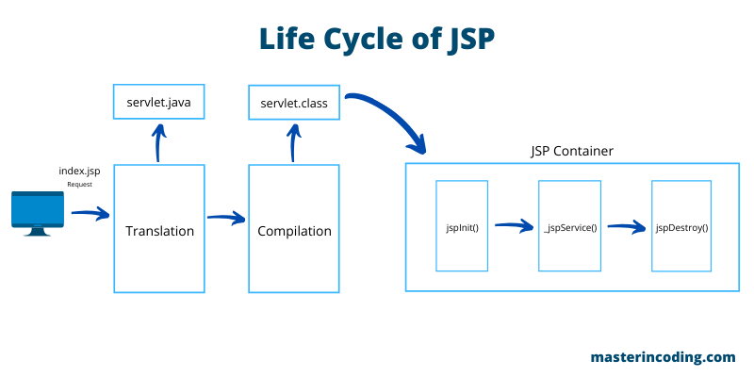
Lifecycle of a JSP Page
During the life cycle , a JSP Page will be available at various stages.
Translation phase
Compilation Phase
Loading a Class File in the memory.
Calling jspinit() method
Calling jspService() method
Calling jspDestroy() method.
CSE(AI&ML) A.Y.:2022-23

Slide 61
Components of JSP Page
Every JSP Page Contains two components
Tags required for presentation logic (HTML)
Tags required for developing JSP code (JSP Elements)
CSE(AI&ML) A.Y.:2022-23

Slide 62
JSP Elements
JSP Elements are classified into 3 types
Scripting Elements
Action Elements
Directive Elements
CSE(AI&ML) A.Y.:2022-23

Slide 63
Scripting Elements
To add java code in the JSP Page use scripting elements.
3 types of scripting elements
Scriptlet
Expression tag
Declarations tage
CSE(AI&ML) A.Y.:2022-23

Slide 64
Scriptlet
It is used to embed any type of java code in JSP Program
Synatx:
<%
// java code
%>
Example:
<%
out.println(“Hello”);
%>
CSE(AI&ML) A.Y.:2022-23

Slide 65
Example Program
<body>
<h1>
<%
out.println(“hello”);
%>
</h1>
<h2>
<%
out.println(“Welcome all”);
%>
</h2>
</body>
CSE(AI&ML) A.Y.:2022-23

Slide 66
Directory Structure
To run any JS application in the web server, we need to follow the directory structure.
Root Directory
WEB-INF
classes
.html files
src
lib
images
web.xml
.css files
.jsp files
CSE(AI&ML) A.Y.:2022-23

Slide 67
Expression Tag
It is used to evaluate the expression. After evaluation the result will be passed to out.println().
Syntax:
<%= expression %>
Example:
<%
int a=3;
int b=2;
%>
<%=a+b%> // it evaluates and display the result
CSE(AI&ML) A.Y.:2022-23

Slide 68
Declarations Tag
It will act as declaration section. It may include variables, method declarations, class definitions.
Syntax:
<%!
Declarations
%>
CSE(AI&ML) A.Y.:2022-23

Slide 69
Example Program
<html>
<body>
<%!
int cube(int n)
{
return n*n*n;
}
%>
<%=cube(4)%>
</body> </html>
CSE(AI&ML) A.Y.:2022-23

Slide 70
Importing Packages
To import any java packages use page directive
Syntax:
<%@ page import= “java.sql.*” %>
<%@ page import= “java.sql.*, java.util.*,java.io.*” %>
CSE(AI&ML) A.Y.:2022-23

Slide 71
Example Programs
Print Hello World
Retrieve the data from form and display.
Multiplication table of the given integer.
Login validation with data base.
Registration Page.
Session Tracking
CSE(AI&ML) A.Y.:2022-23

Slide 72
Action Elements
Each JSP action tag is used to perform some specific tasks.
jsp:forward | forwards the request and response to another resource.
jsp:include | includes another resource.
jsp:plugin | embeds another components such as applet.
jsp:param | sets the parameter value. It is used in forward and include mostly.
CSE(AI&ML) A.Y.:2022-23

Slide 73
jsp:forward action tag
The jsp:forward action tag is used to forward the request to another resource it may be jsp, html or another resource.
<jsp:forward page=“file_name" />
CSE(AI&ML) A.Y.:2022-23

Slide 74
Example of jsp:forward action tag with parameter
<html>
<body>
<h2>this is index page</h2>
<jsp:forward page="print.jsp" >
<jsp:param name="name" value=“Aswadh" />
</jsp:forward>
</body>
</html>
CSE(AI&ML) A.Y.:2022-23

Slide 75
<html>
<body>
<%= request.getParameter("name") %>
</body>
</html>
CSE(AI&ML) A.Y.:2022-23

Slide 76
jsp:include action tag
The jsp:include action tag is used to include the content of another resource it may be jsp, html or servlet.
The jsp:include tag can be used to include static as well as dynamic pages.
Syntax:
<jsp:include page="print.jsp" />
CSE(AI&ML) A.Y.:2022-23

Slide 77
<jsp:include page="relativeURL">
<jsp:param name="parametername" value="parametervalue" />
</jsp:include>
CSE(AI&ML) A.Y.:2022-23

Slide 78
Implicit objects of JSP
There are 9 jsp implicit objects. These objects are created by the web container that are available to all the jsp pages.
out
request
response
config
application
session
pageContext
page
exception
CSE(AI&ML) A.Y.:2022-23

Slide 79
Out:
For writing any data to the buffer, JSP provides an implicit object named out.
out.print(“Message”);
Request:
The JSP request is an implicit object of type HttpServletRequest i.e. created for each jsp request by the web container.
<%
String name=request.getParameter("uname");
out.print("welcome "+name);
%>
CSE(AI&ML) A.Y.:2022-23

Slide 80
Response:
In JSP, response is an implicit object of type HttpServletResponse. The instance of HttpServletResponse is created by the web container for each jsp request.
<%
response.sendRedirect("http://www.google.com");
%>
CSE(AI&ML) A.Y.:2022-23

Slide 81
Session:
In JSP, session is an implicit object of type HttpSession.The Java developer can use this object to set,get or remove attribute or to get session information.
Example:
session.setAttribute("user",name);
String name=(String)session.getAttribute("user");
CSE(AI&ML) A.Y.:2022-23

Slide 82
exception:
In JSP, exception is an implicit object of type java.lang.Throwable class. This object can be used to print the exception. But it can only be used in error pages.
To handle, the exceptions it can be used.
CSE(AI&ML) A.Y.:2022-23

Slide 83
Example
<%@ page errorPage="error.jsp" %>
<%
String num1=request.getParameter("n1");
String num2=request.getParameter("n2");
int a=Integer.parseInt(num1);
int b=Integer.parseInt(num2);
int c=a/b;
out.print("division of numbers is: "+c);
%>
CSE(AI&ML) A.Y.:2022-23

Slide 84
error.jsp
<%@ page isErrorPage="true" %>
<h3>Sorry an exception occured!</h3>
Exception is: <%= exception %>
CSE(AI&ML) A.Y.:2022-23

